Slide 1
Loan Case Study
By - Chetan Mahajan

Slide 2
Problem Statement
To develop a basic understanding of risk analytics in banking and financial services and understand how data is used to minimize the risk of losing money while lending to customers.
Identification of such applicants who are capable of replaying the loan.
Identification of applicants who can likely to be defaulters.

Slide 3
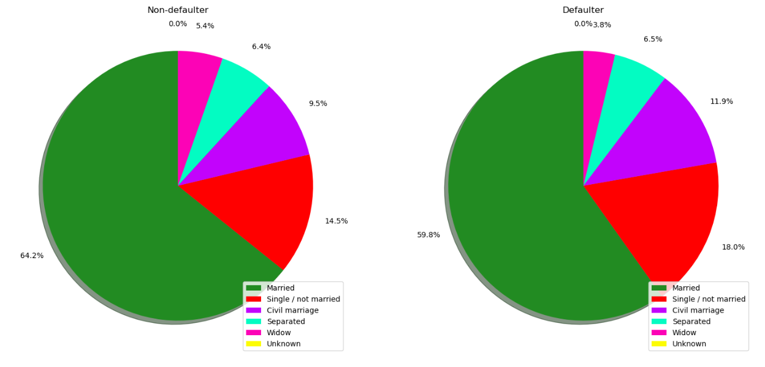
Likely Non-Defaulters vs Defaulters
Based on Relationship status
Preferred choice to approve loans – Married applicants
Preferred choice not to approve loans – Single applicants

Slide 4
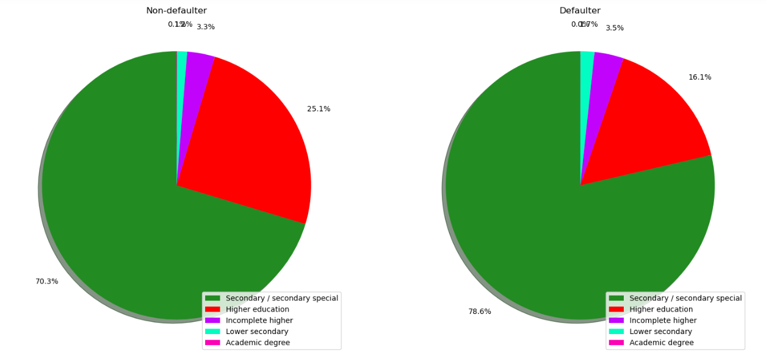
Based on Applicants Education
Preferred choice to approve loans – Higher Education
Preferred choice not to approve loans – Secondary Education

Slide 5
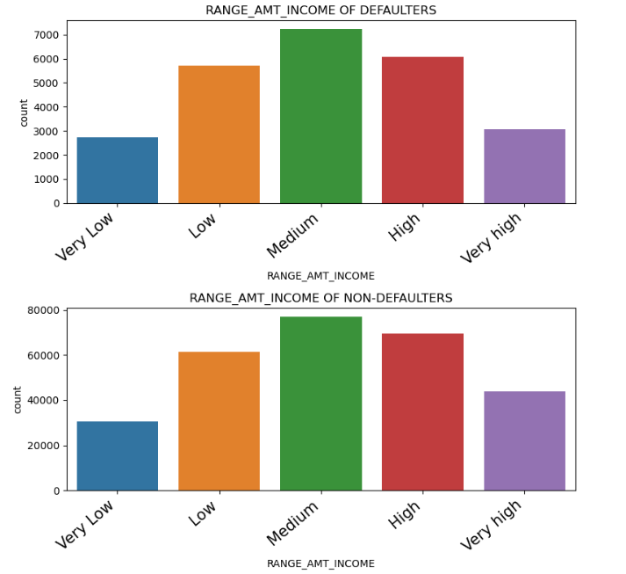
Based on Income of applicants
Preferred choice to approve loans – High and Very High Income
Preferred choice not to approve loans – Low and Very Low Income

Slide 6
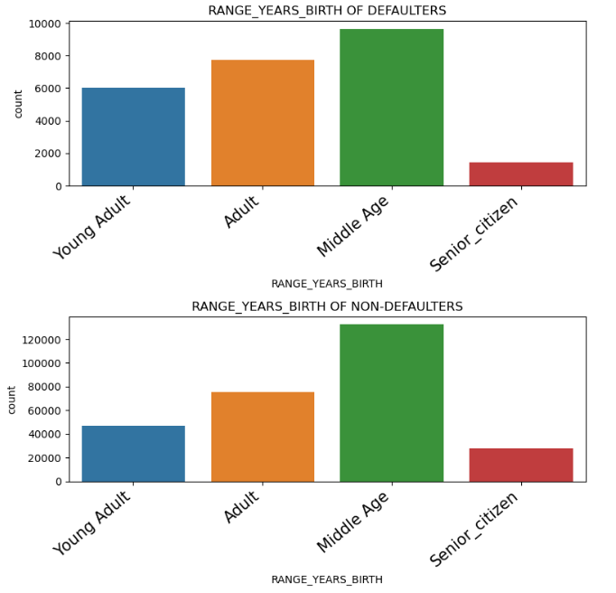
Based on Age of applicants
Preferred choice to approve loans – Middle Age and Senior_citizen
Preferred choice not to approve loans – Young Adult and Adult

Slide 7
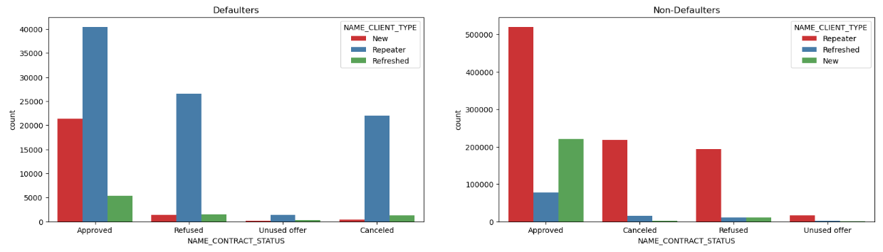
Based on Contract Status and Client Type
Preferred choice to approve loans – Approved previous applications
Preferred choice not to approve loans – Refused previous applications

Slide 8
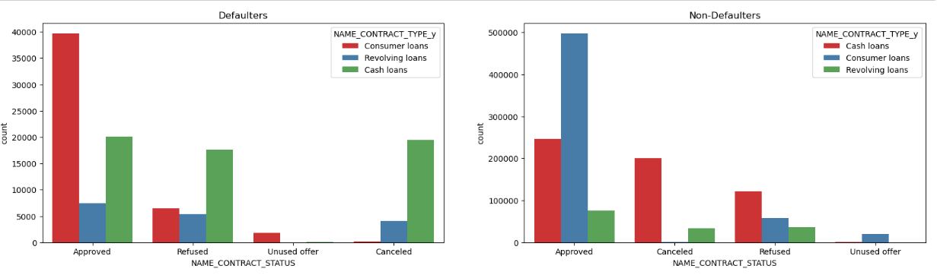
Based on Contract Status and Contract Type
Preferred choice to approve loans – Consumer loans of previous applications
Preferred choice not to approve loans – Revolving loans of previous applications

Slide 9
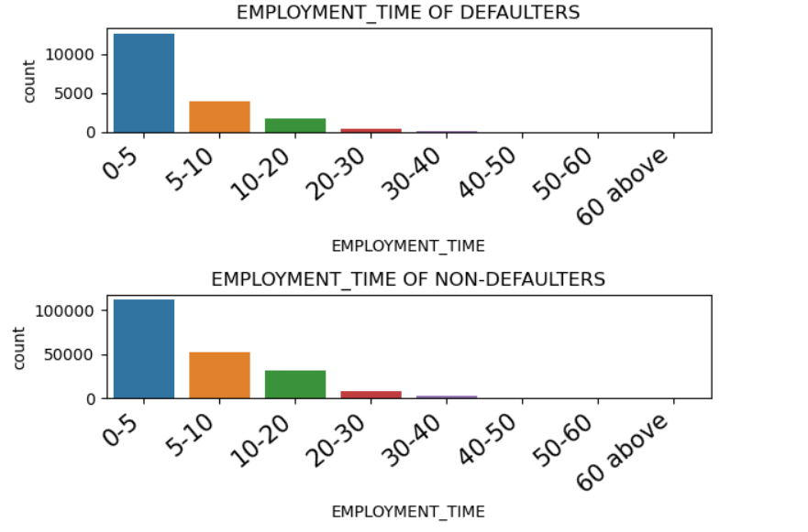
Based on Employment time
Preferred choice to approve loans – 40+ years of experience
Preferred choice not to approve loans – 0-5 years of experience

Slide 10
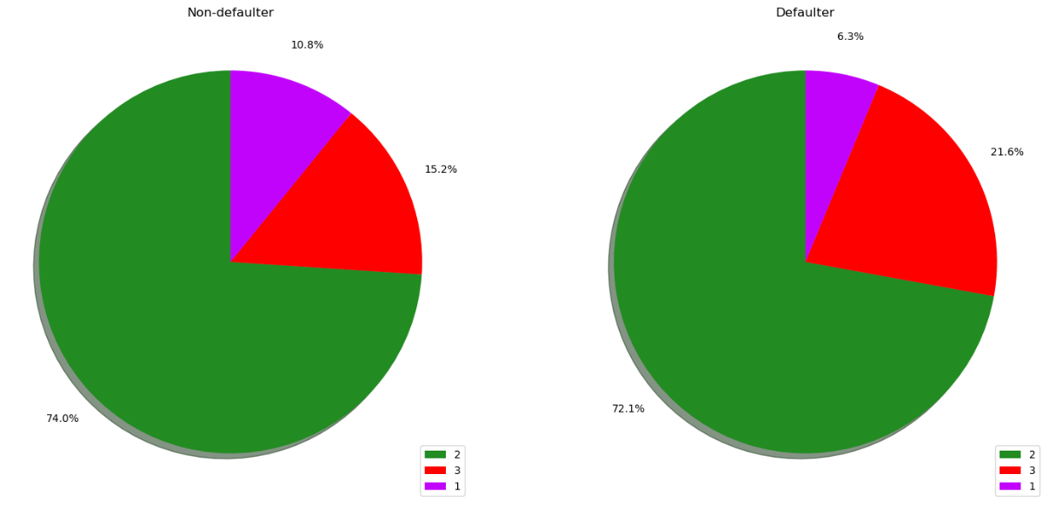
Based on Region rating
Preferred choice to approve loans – Region rating 1
Preferred choice not to approve loans – Region rating 3

